Slide 1
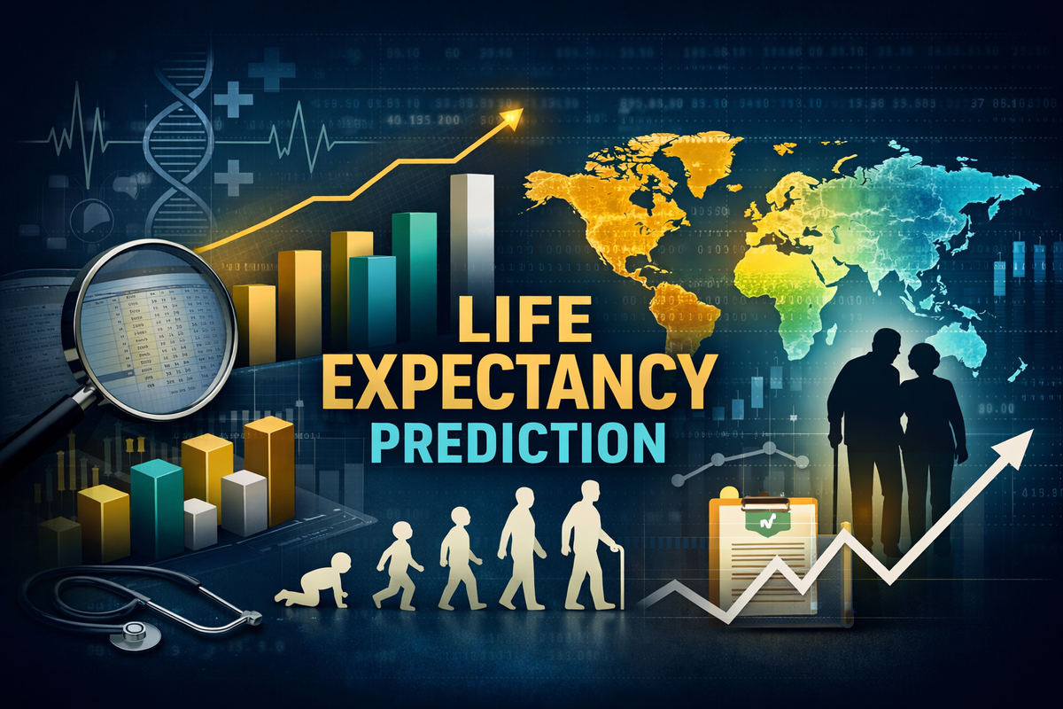
Global Life Expectancy: Analyzing Trends and WHO Metrics
Presented by: Menna Tuallah Ahmed

Slide 2
Project Objective
1-Predict the average life expectancy of countries
based on health, economic, and social indicators.
2-Analyze the impact of factors like GDP,
immunization, mortality rates, and BMI
on life expectancy levels
3-Support policymakers and healthcare
organizations with data-based insights
to improve population health outcomes

Slide 3
Data Description
Key Data Attributes Libraries
•Country • GDP • NumPy → Numerical Analysis
•Year • BMI • Pandas → Data Processing
•Status • Population • Matplotlib → Visualization
•Life expectancy • Schooling • Seaborn → Statistical Plots
• Adult Mortality • Alcohol • Scikit-learn → Machine Learning
•Infant deaths •Immunization rates

Slide 4
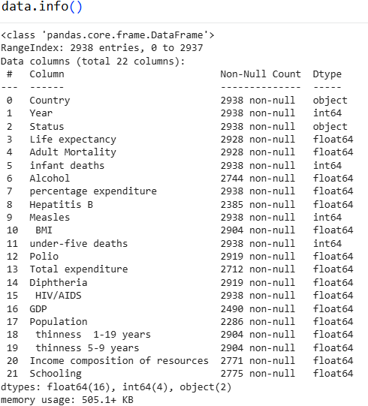
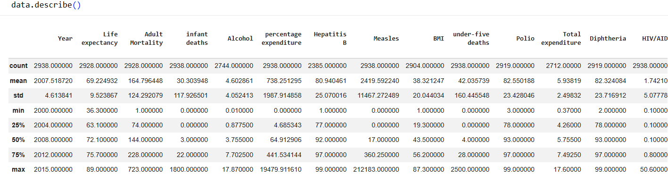
Data Exploration and Preprocessing Strategy
The dataset was carefully explored and cleaned to ensure high data quality before training the model.Several preprocessing steps were applied to handle missing values, outliers, and ensure data consistency.
Initial Data Exploration
• Used df.info() to review data types and non-null values
• Used df.describe() to analyze statistical distribution
• Explored feature relationships and overall dataset structure

Slide 5
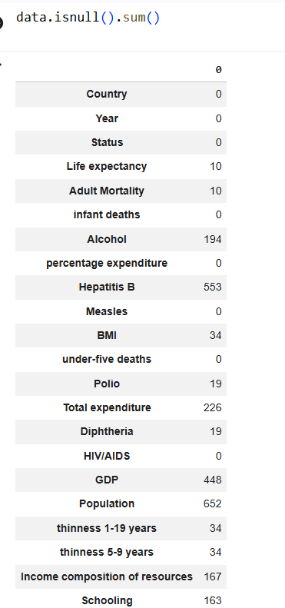
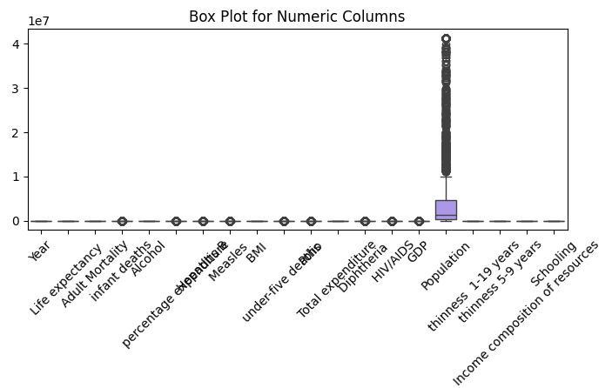
Missing Data & Outlier Treatment
Missing Values Handling
Missing values were detected and handled appropriately to maintain dataset quality.Columns that contained missing values included:
• Life expectancy
• GDP
• BMI
• Schooling
• Alcohol
Outlier Detection & Treatment
Outliers were identified using statistical analysis and visualization techniques.
Columns where outliers were detected:
• GDP
• Population
• Adult Mortality
• Infant deaths
• Measles
• BMI
•Total expenditure

Slide 6
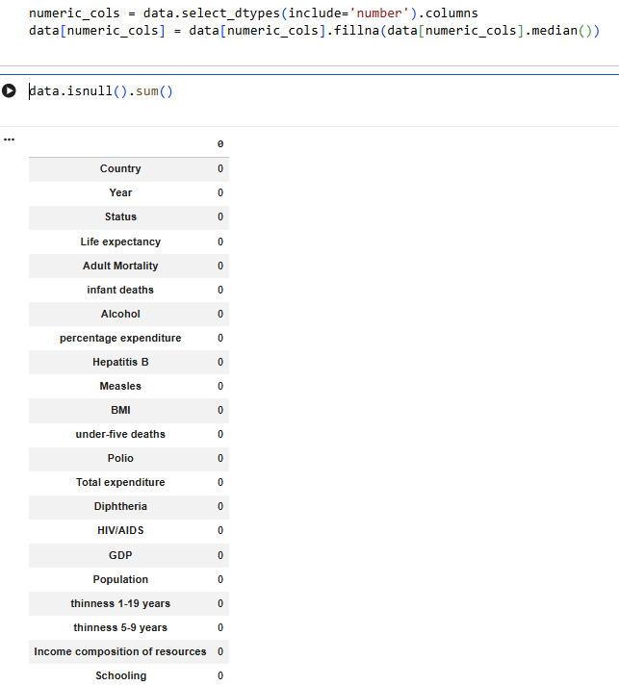
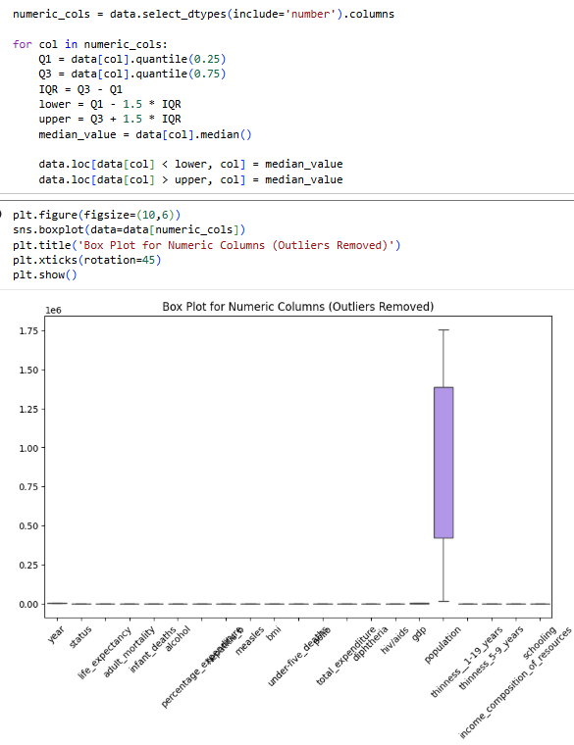
Handling Missing Values and Outliers
In this step, we addressed missing data by imputing the median value for all numerical columns. As shown in the result, data.isnull().sum() confirms that all columns now have zero missing entries, ensuring our dataset is clean and ready for modeling.
Used the Interquartile Range (IQR) method to identify outliers in numerical columns.
Replaced outliers (outside the lower/upper bounds) with the median value to maintain model stability.
Generated a Box Plot to visualize the data distribution after outlier removal

Slide 7
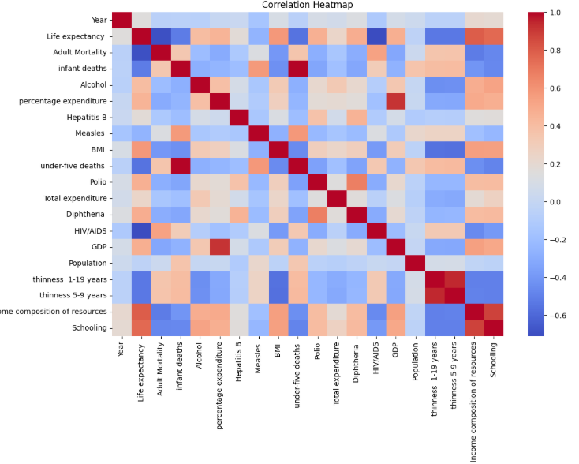
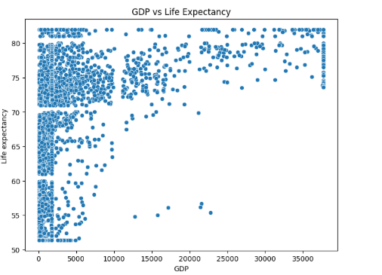
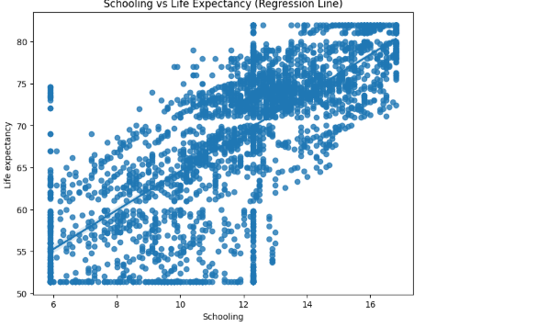
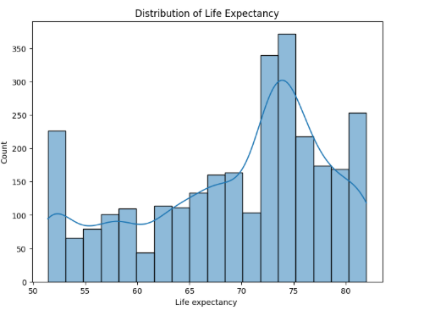
Description of Visualizations
Variable Correlations: The heatmap reveals variables most strongly correlated with life expectancy (e.g., Schooling, GDP), helping in feature selection for the model.
Relationship with GDP: Generally positive correlation; countries with higher GDP tend to have higher life expectancy.
Impact of Schooling: The regression line shows a strong positive relationship; increased years of schooling directly correlate with higher life expectancy.
Life Expectancy Distribution: The histogram visualizes the distribution of life expectancy across countries, with a significant concentration between 70 and 75 years.

Slide 8
Analytical Insights
Heat Map strong Correlation: As Schooling or GDP increases, Life Expectancy significantly increases
Scatter Plot Positive Trend: Data scatters upwards, meaning countries with higher GDP have higher life expectancy, though variability decreases in wealthier nations.
Regression Linear Increase: A clear line rises from left to right; as years of schooling increase, life expectancy increases steadily and predictably
Histogram Distribution: Most data (number of countries) is concentrated on the right side (high life expectancy), with a "gap" in the middle of the distribution.

Slide 9
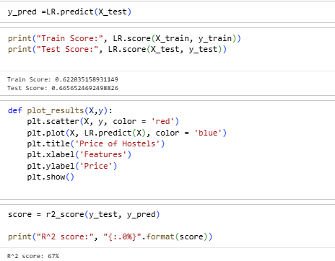
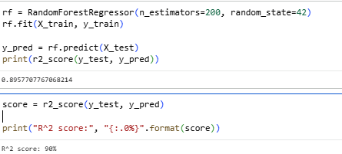
Predicting Life Expectancy: From Baseline to High Accuracy Modals
Baseline Model: Linear Regression
Simple, interpretable model
R² score: ~67% → moderate performance
Predicted life expectancy trend captured basic linear relationships
Improved Model: Random Forest Regressor
Ensemble model capturing non-linear relationships
R² score: ~90% → significant improvement
Better predictions for countries with extreme values

Slide 10


Conclusion
In conclusion, our analysis reveals that increasing global life expectancy is not solely dependent on medical care, but is strongly correlated with education and GDP. By cleaning the data and handling outliers, we successfully built a predictive model with 90% accuracy, helping policymakers target the most impactful sectors to improve quality of life.
Thank You

